Slide 1
Journey Presentation- Custom Week 1
By, Louie Antony

Slide 2
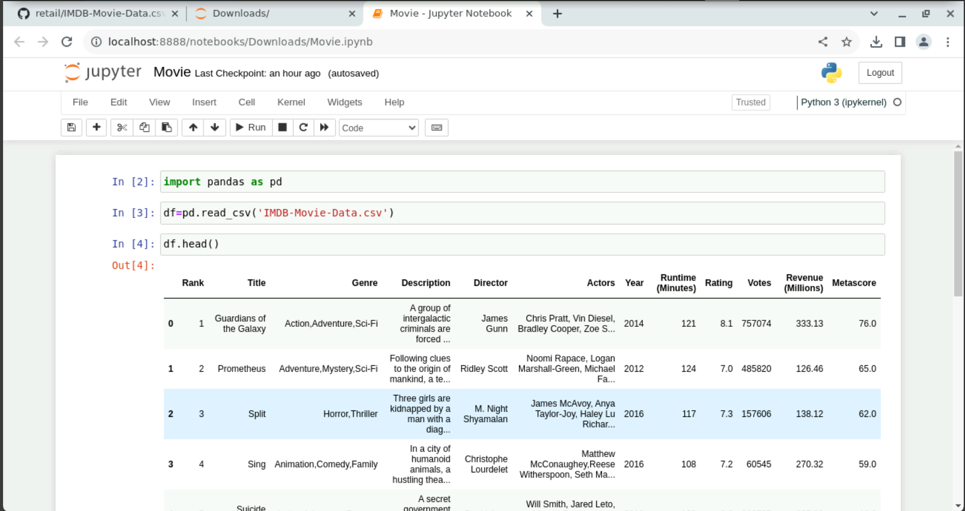
Loading the data

Slide 3
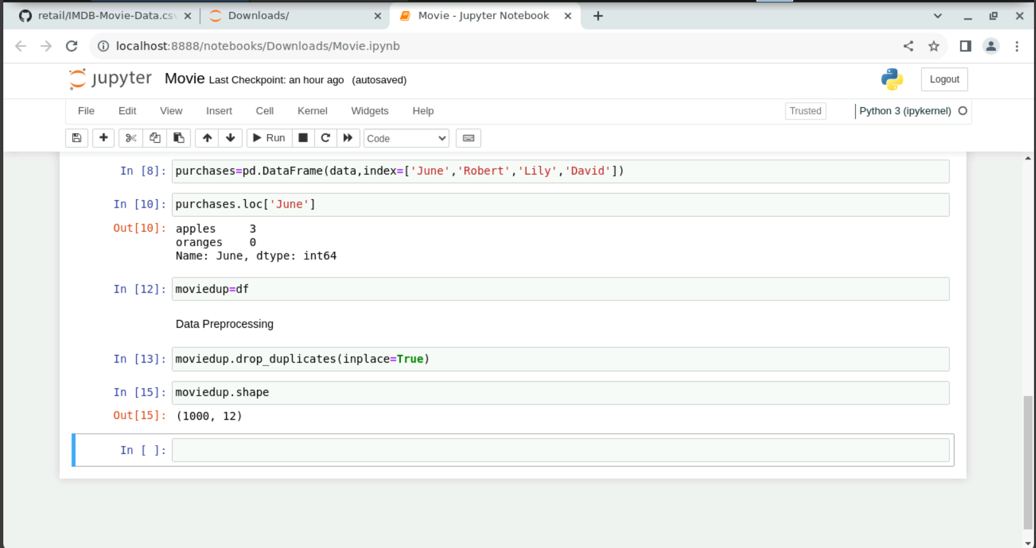
Data Preprocessing

Slide 4
Thank You

